Slide 1
Raxter – Publication Classifier
David Walsh
Josh Reaves
Brian BUI
Jonathon benson

Slide 2
Allows user to quickly look over research papers. Can determine which sentences are worth looking over based on assignment.
Why use this?

Slide 3



What does it do?
A web app.
Analyzes research paper .pdf
.pdf text is separated into phrases.
Each phrase is designated a classification ranked by importance in the text.
Core
Peripheral
Other

Slide 4
Flow
A user can upload a research paper .pdf to be analyzed.
Determines Core, Peripheral and Other based on the most occurring words within the .pdf.
The most used consecutive words are checked for in phrases.
The result is outputted to a web where human can judge prediction by Accepting / Rejecting.

Slide 5


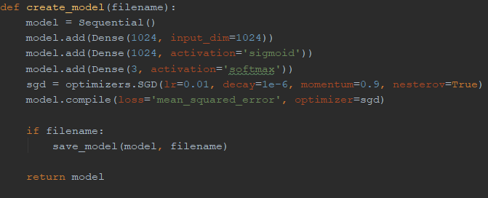
How does it predict?
Machine learning
Uses Sequential Model

